Slide 1
EXERCISE 1 Aditya kumar Mishra cheella sree harsha

Slide 2
AGENDA
Fork the given Github Repository
Clone the Repository on Local Machines
Create a Frontend Folder
Create a Backend Folder
Raise a Pull Request

Slide 3
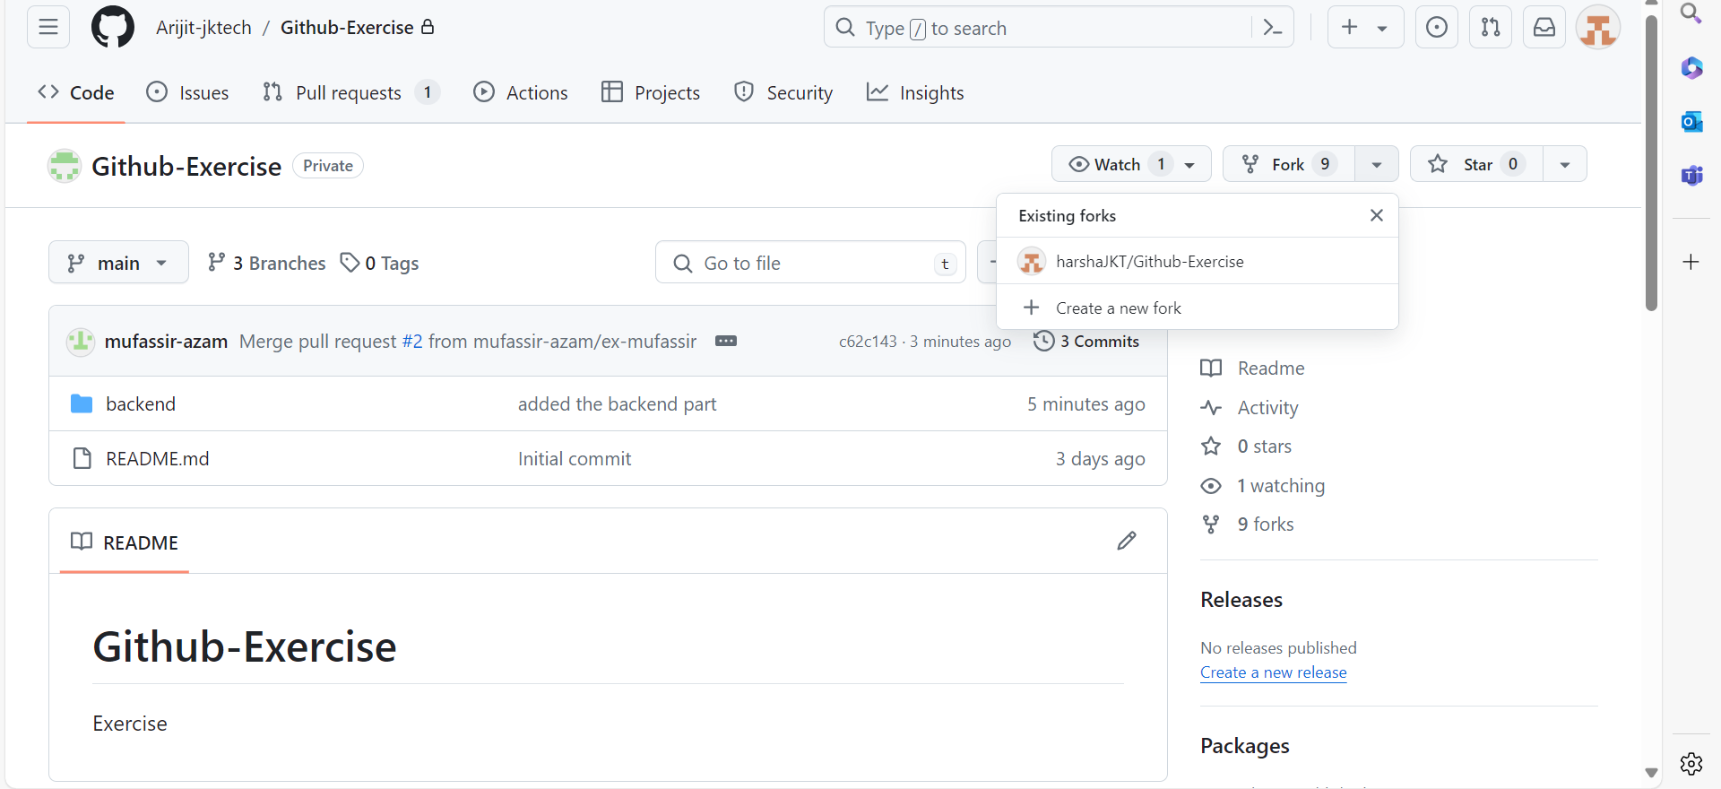
Forking the repository

Slide 4
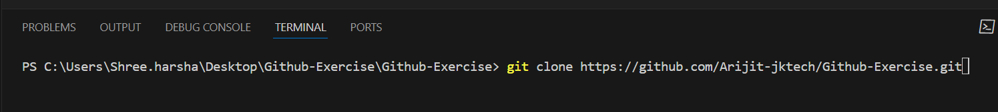
Cloning repository in local machines

Slide 5
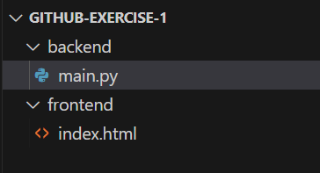
Creating directories in local machine

Slide 6
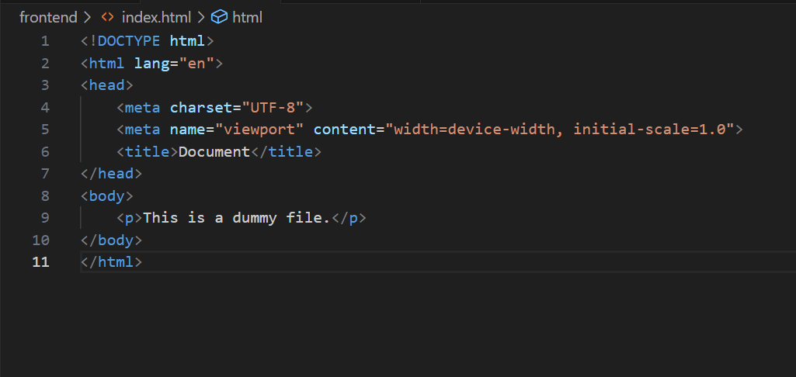
Frontend files

Slide 7
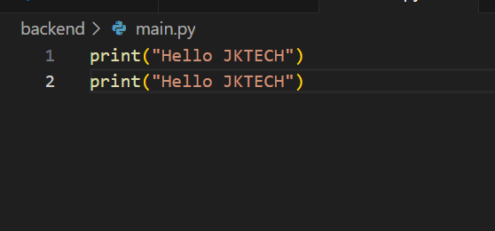
Backend files

Slide 8
Committing the changes made

Slide 9
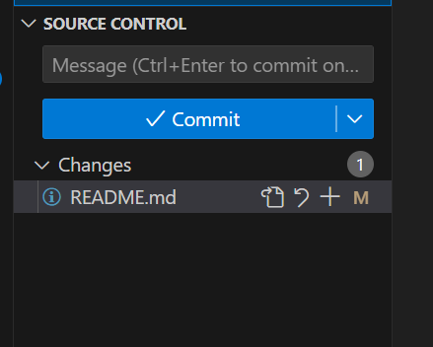
Adding the readme file

Slide 10
Thank you!

